Slide 1
Object Storage
CS4981 ML Production Systems
RJ Nowling

Slide 2
Data Processing Tasks
Reorganize data sets to enable parallel / distributed processing
Clean data sets
Join / combine data sets
Identify events for labeling records
Compute aggregations (e.g., number of page views per day)
Extract data into new variables (e.g., street names from addresses)
Pre-process images (crop, rotate, etc.)

Slide 3
Data Processing Pipelines
These pipelines often run offline
Focus is on throughput, not latency
Data are accumulated and processed in large batches
Hence “batch processing”

Slide 4
Storing and Moving Data Around as Files
Files are good for storing batches of data when multiple processes / programs do not need concurrent write access
Files are stored and shared in object stores:
Files are uploaded to object stores by one component / system
Each file has a unique, universal URL
The URLs are passed around one component to another
Files are downloaded by the next component / system
Object storage services are provided by cloud providers and generally pretty inexpensive
Only need to spin up (and pay for) compute instances when doing the actual data processing

Slide 5
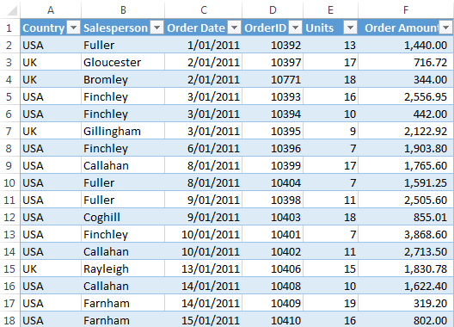
Tabular Data
The easiest data to work with is tabular data
Records are organized into rows
Variables are organized into columns (fields)
Each variable has a type (e.g., int, text, etc.)
Commonly stored in relational databases or spreadsheets
https://www.myonlinetraininghub.com/excel-tabular-data-format

Slide 6
Structured vs Unstructured Data
Semi-structured
Structured
JSON
CSV
Generally semi-structured data becomes more structured as the it goes further down the data pipelines
Tables of data
Each row is a sample
Each column is a variable
Variables have well-defined types (e.g., ints, Strings)
Relational constraints
Unstructured
Text data (e.g., user reviews)
Images

Slide 7
Tabular Text Files
Plain text
One record per line
Fields are separated by commas (CSV) or tabs (TSV)
Fields may be quoted (with double or single quotes) – used when fields contain commas or newlines
Since the type of a given column is not specified or enforced, the types of fields are often interpreted incorrectly and need to be manually fixed
Timestamp,Blood Glucose,Prior Activity
2016-05-07 08:05 PM,202,
2016-05-07 09:04 PM,237,
2016-05-07 10:15 PM,215,
2016-05-08 07:14 PM,228,
2016-05-09 04:19 AM,210,
2016-05-09 08:36 AM,246,
2016-05-09 12:47 PM,207,
2016-05-10 08:09 AM,248,
2016-05-11 12:09 AM,324,
2016-05-11 09:00 AM,244,
2016-05-12 02:14 PM,196,
2016-05-12 04:03 PM,125,Biking

Slide 8
JavaScript Object Notation (JSON)
A subset of JavaScript used to describe hierarchical data
Types: String, float, array, object (dictionary)
Object field names must be strings, values can be of any type
Each JSON files starts with a top-level object
Everything is stored in a text file
{"to": "the00@speedy.uwaterloo.ca", "from": "\"Tomas Jacobs\" <RickyAmes@aol.com>",
"subject": "Generic Cialis, branded quality@ ",
"body": "\n\n\n\n\n\n\nDo you feel the pressure to perform and not rising to the occasion??\n\n\n\n\nTry Viagra.....\nyour anxiety will be a thing of the past and you will\nbe back to your old self.\n\n",
"user-agent": "Microsoft Outlook Express 6.00.2600.0000",
"date": "Sun, 08 Apr 2007 21:00:48 +0300",
"label": 1}

Slide 9
Advantages of Binary Representations
Binary representations are more compact (e.g., 32-bit int vs string of digits)
Types are remembered
No loss of fidelity from converting between types / representations
Faster reading and writing (e.g., parsing is quicker)
Binary JSON formats:
BSON
MessagePack

Slide 10

Feather
File format for storing a single table of data
Stores data in binary (e.g., no converting ints to strings of digits) – more space efficient
Preserves type information – avoid typing errors
Provides LZ4 and ZSTD lossless compression
Does not automatically perform partitioning -- data processing software needs to manage writing each partition to its own file

Slide 11

Apache Parquet
A binary file format for tabular data
A single data set is partitioned across multiple files
Data are compressed and index
Designed to be used by batch processing systems
User specifies an object store or file path
System automatically writes out the data from each partition to a separate file
When loaded back in, the data remain until the partitioned format

Slide 12

SQLite
Provides a SQL database management system as a library
No externally running processes, services, or network connection required
The database is stored in a single file
Provides: tables, full SQL query support, extras like JSON columns
Does not implement: foreign key constraints
Single thread can write, multiple threads can read in parallel
Fast, reasonable file sizes
Each partition of data can be written to a separate SQLite file

Slide 13
DuckDB
Provides a SQL database management system as a library
Similar features / limitations as SQLite
Optimized for analytics
Data are organized by column:
Traditional SQL databases write each record as a contiguous unit. When selecting many rows but few columns, all of the data for the selected records are read from disk
In a columnar store, each column is written as a contiguous unit. Only need to read values you want
Each partition of data can be written to a separate DuckDB file

Slide 14
Object Stores
A service that stores and manages objects
Commonly accessed via REST interface over HTTPS
Read, write, delete, and list objects
Objects are indexed by unique URLs
Key: filename (URL)
Value: object (file)
Objects are several to 100's of MBs (can be up to GBs)
Object stores are the foundation of modern, cloud-based distributed computing solutions

Slide 15
Object Stores for Distributed Computing
Object stores are the foundation of modern, cloud-based distributed computing solutions
Optimized for throughput – handling many clients at once – over latency
Object stores are run on multiple physical servers but that is hidden from the user
Enables reliability (objects are duplicated) and performance
Offered as a service by cloud providers
Inexpensive, no need for developers to manage anything

Slide 16
Notable Object Store Implementations
Cloud Services
Open Source (Installable Locally)
Amazon Web Services (AWS) Simple Storage Service (S3)
Google Cloud Storage
Azure Blob Storage
Minio
Ceph
SeaweedFS

Slide 17
Objects as Atomic Units
Objects are not divisible
Operations are performed on the entire object
No random access -- cannot read or write part of an object
Different from a file system
Why? Avoids fine-grain locking, making it easier to scale up

Slide 18
Eventually Consistent
Multiple readers will not see new / update objects immediately -- there is some delay
Allows the system to remain accessible even when part of the cluster is disconnected from the rest
Inconsistency time windows are relatively short (fewer than a couple of seconds)
Conflict resolution: last write wins. No attempt to merge changes.
Why? Performance. Avoids locks / coordination.

Slide 19
Objects Indexed by URLs
Each object is associated with a unique URL
The URLs are absolute paths -- valid no matter the context of the client
Can be passed from program to program or machine to machine
Store data in object store
Send URL to process running on another machine
Process downloads data at URL

Slide 20
URL example
https://[bucket-name].s3.[region-code].amazonaws.com/[key]
https://DOC-EXAMPLE-BUCKET1.s3.us-west-2.amazonaws.com/puppy.png
Bucket: DOC-EXAMPLE-BUCKET1
Region: us-west-2
Key: puppy.png

Slide 21
Example
https://nowling-lab.s3.us-east-1.amazonaws.com/
genomes
aedes
Aedes-aegypti-LVP_AGWG_CHROMOSOMES_AaegL5.fa
anopheles
Anopheles-gambiae-PEST_CHROMOSOMES_AgamP4.fa
drosophila
dmel-all-chromosomes-r5.34.fa
dmel-all-chromosomes-r6.45.fa

Slide 22
Directory Hierarchy
Object stores do not support real directories
They mimic the functionality
The path is part of the key
https://nowling-lab.s3.us-east-1.amazonaws.com/genomes/drosophila/dmel-all-chromosomes-r6.45.fa

Slide 23
Directory Hierarchy (List Everything)
genomes/aedes/Aedes-aegypti-LVP_AGWG_CHROMOSOMES_AaegL5.fa
genomes/anopheles/Anopheles-gambiae-PEST_CHROMOSOMES_AgamP4.fa
genomes/drosophila/dmel-all-chromosomes-r5.34.fa
genomes/drosophila/dmel-all-chromosomes-r6.45.fa

Slide 24
Directory Hierarchy (List Everything with Prefix)
Prefix: genomes/drosophila
genomes/drosophila/dmel-all-chromosomes-r5.34.fa
genomes/drosophila/dmel-all-chromosomes-r6.45.fa

Slide 25
REST over HTTPS
Commonly use REST over HTTPS for manipulating objects
GET
PUT
DELETE
POST
Allows object stores to serve static resources for web sites
Allows allow client and servers to run as regular users (no kernel modules or administrative privileges required)

Slide 26
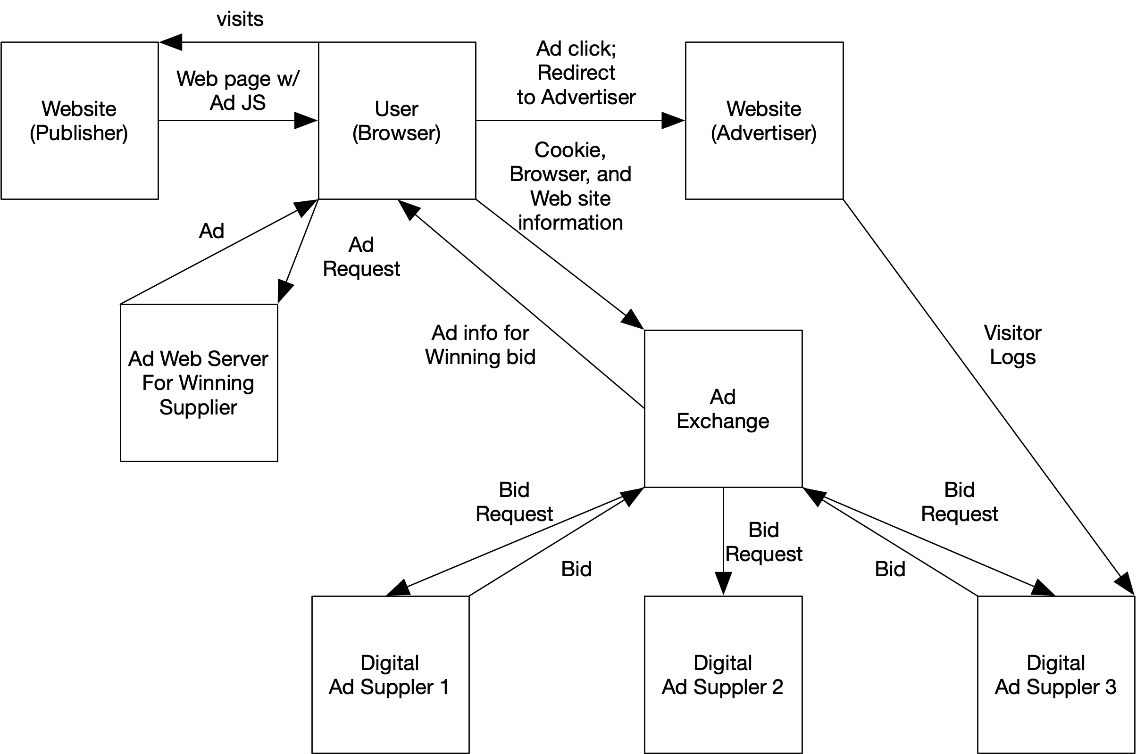
Real-Time Ad Serving

Slide 27
Training and Testing Events
Past
Label

Slide 28
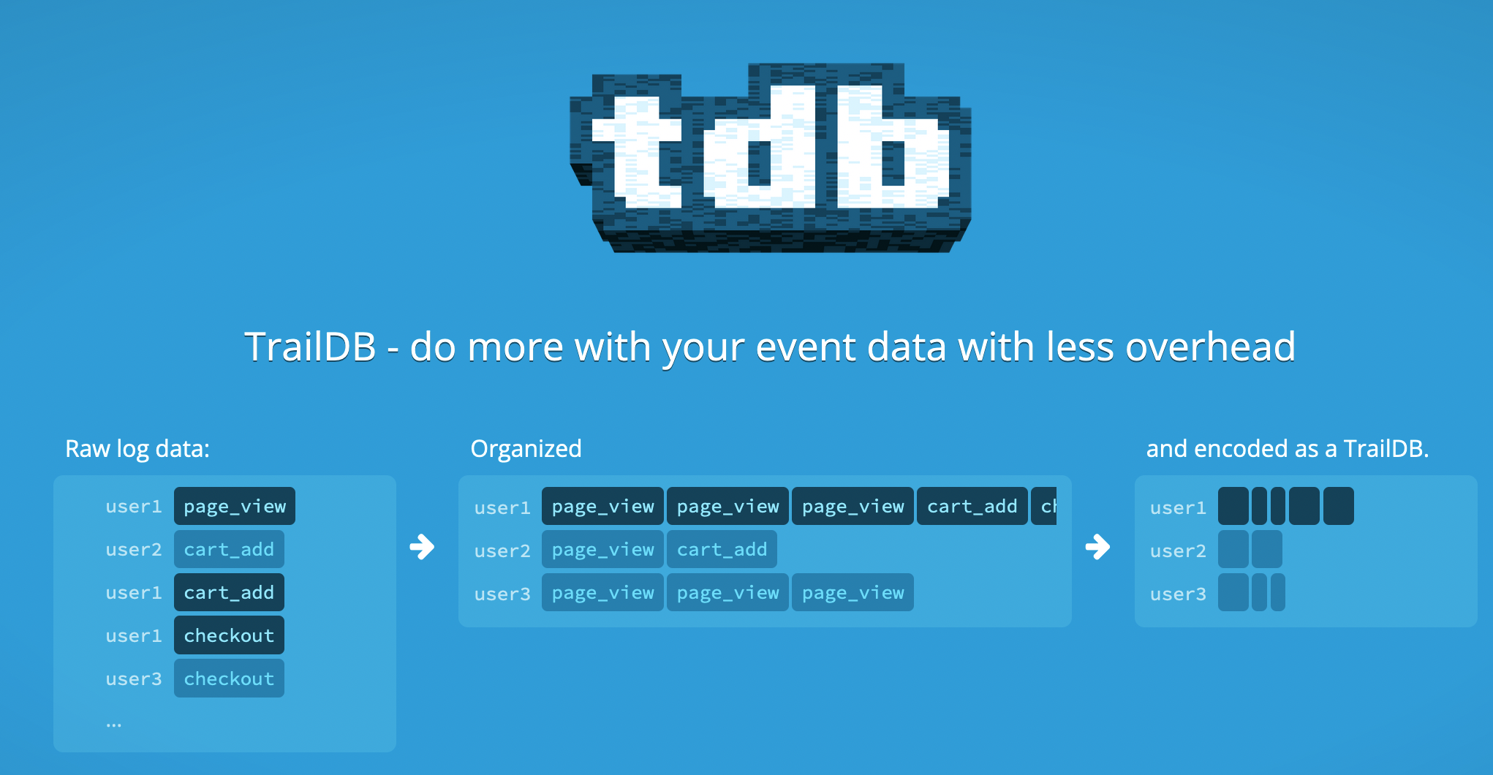
TrailDB

Slide 29
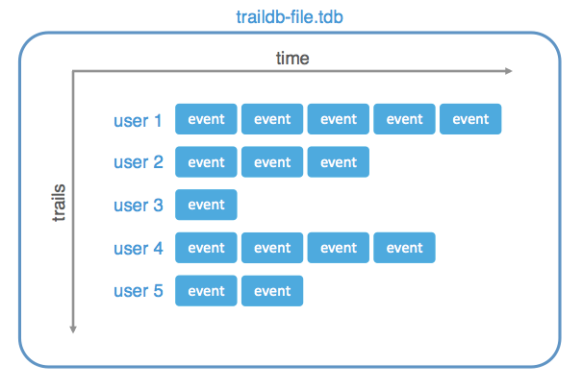
Events
Events are structs containing:
User UUID (128 bits)
Timestamp (64 bits)
Key-value pairs
String keys
Categorical values

Slide 30
Trails
Events are organized by UUID
Even trail is a list of events for a UUID
Sorted by timestamp
Delta encoding of the timestamps are used to reduce space

Slide 31
TrailDB File
A file is map of UUIDs to trails of events for each UUID

Slide 32
TrailDB Compression
TrailDB files are read-only once created
During creation, the data are compressed:
For each field, a set of all observed values is created. A table of String values to variable-length integers. Huffman coding is used to key the most frequent values having the shortest bit strings.
Since events are sorted by timestamp, delta encoding is used to store the timestamps within a given trail
Organizing events by UUID avoids storing each UUID more than once
Values are decompressed at run time
A cursor (iterator) interface is used for accessing values

Slide 33
What Could Go Wrong?
The C implementation was not robust to very large string values
We had more than a few issues where the TrailDBs that were generated not readable
Crashed the pipelines, hard to debug and fix
Often put in manual filters in upstream parts of the pipeline to exclude bad records rather than truly fixing the C library to handle the data better

Slide 34
Practical Advice
Object stores are great for storing data in bulk
Object stores are a foundation for distributed computing
Fast for bulk transfers
Support multiple readers
Use object organization to avoid overlapping reads / writes
Use file formats that preserve types (e.g., Parquet, Feather, SQLite, BJSON)
Use file formats supported by large and active communities (don’t reinvent the wheel)

